Slide 1
Temperature Monitoring
and Control
Mentored By : Dr. Rambabu Kalla
Abhishek Prusty
Arhant Jain

Slide 2
• To Monitor and Control the Temperature in a Cardboard Cabin of 30 cm³.
• A Feedback Control System is to be designed to maintain the Temperature in the cabin to the Temperature set by the User.
• A Display of the current temperature along with Recording of Temperature over a specific period of time.
AIM

Slide 3
Applications
• Can be used for Comfort of Normal User.
• For Easy as well as Effective control over the working of various discrete element (controlling temperature.)
• To maintain the temperature even when there is no human supervision. (eg Biology Lab) changing the working of different components as per change in environment without the help of Human.
• To Save Power Usage in fan and light bulb.
• Integrating it with Internet of Things.

Slide 4
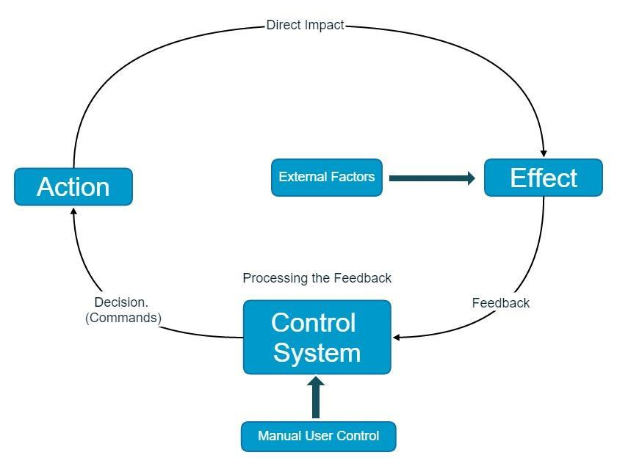
Workflow

Slide 5
SUBDIVISION OF PROBLEM
1. Sensing Temperature
2. User Interface for Control
3. Action Systems
4. Control System

Slide 6
1.SENSING OF TEMPERATURE
Idea:
• Easiest way of achieving it would be to use diode and measure the change in the voltage.
• However more preferable would be to use LM35 sensor which uses transistors instead of just diode and give better result.
• Output of this sensor is feedback to control unit.
I

Slide 7
Implementation:
• LM35 sensor is used which changes the output
voltage between the reference voltage and
ground as per the room temperature.
• LM35 works for whole range of -55 ̊ to 150 ̊ C
• This output terminal given to ADC and analog
value is read. This analog value is then
multiplied by proper scaling to get answer in
degree Celsius.• I.e. Answer of analog value between 0-1023 is
divided by 9.31 for 5V reference voltage to get
box temperature.
Implementation:
• LM35 sensor is used which changes the output voltage between the reference voltage and ground as per the room temperature.
• LM35 works for whole range of -55 ̊ to 150 ̊ C.
• This output terminal given to ADC and analog value is read. This analog value is then multiplied by proper scaling to get answer in degree Celsius i.e. answer of analog value between 0-1023 is divided by 9.31 for 5V reference voltage to get box temperature.

Slide 8
2. USER INTERFACE
2. USER INTERFACE
Idea:
• A simple screen to display Log.
i.e we are using 16:2 LCD Display for showing Current as well as Set Temp. value.

Slide 9
Implementation:
• 16:2 LCD Display will be connected with Microcontroller.
• First line will display Set temperature and Next line will display Present Temperature.

Slide 10
3.ACTION SYSTEM
Idea:
• To decrease the temperature: 2 Exhaust Fan with sink and blow are used.
• To increase the temperature: 100 watt Bulb. (Ideally heater but as cube is small 100 watt bulb should work.)

Slide 11
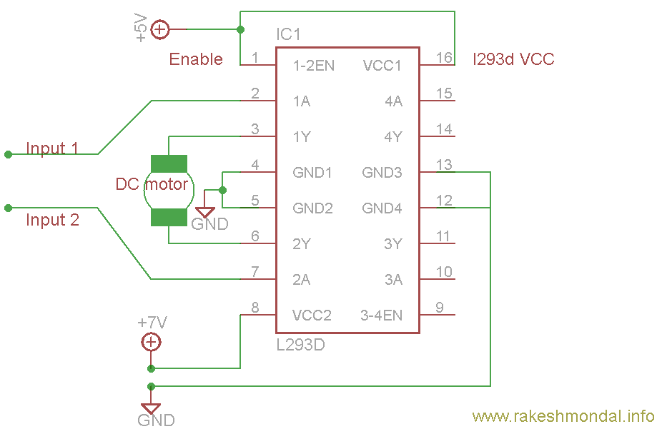
.

Slide 12
Implementation : Bulb
• Bulb is driven though AC voltage whereas rest of the circuit is DC. This creates a big problem.
• We want to control the Triac which in turn controls the AC voltages as per the voltage in the gate. But we cannot directly give this gate current from out DC circuit.
• For this reason, we require an Optocoupler to communicate between this AC and DC. (Optocoupler contains LED and LDR)

Slide 13
Proportional and Integral Controller
In our project,PID is used as a control loop feedback mechanism.This PID controller continuously calculates an error value e(t) as the difference between a Desired value and the Measured value and applies a correction based on proportional, integral, and derivative terms.
It automatically applies accurate and responsive correction to a control function. Thus,we get more accurate results.

Slide 14
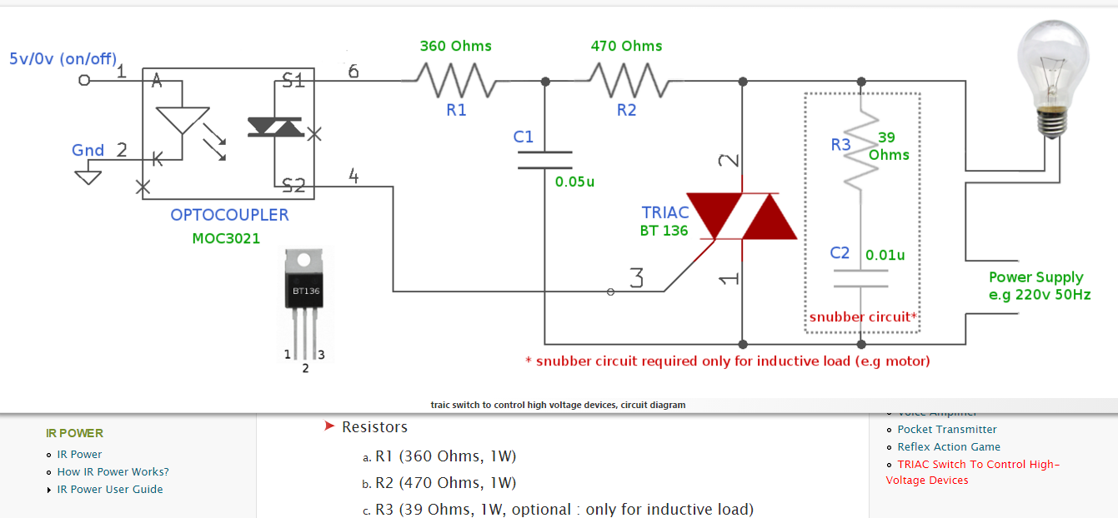

Slide 15
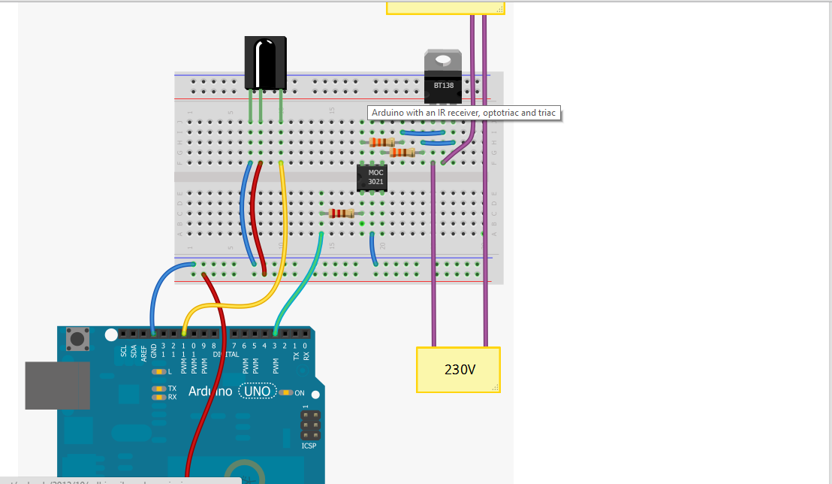
Fritzing Design

Slide 16
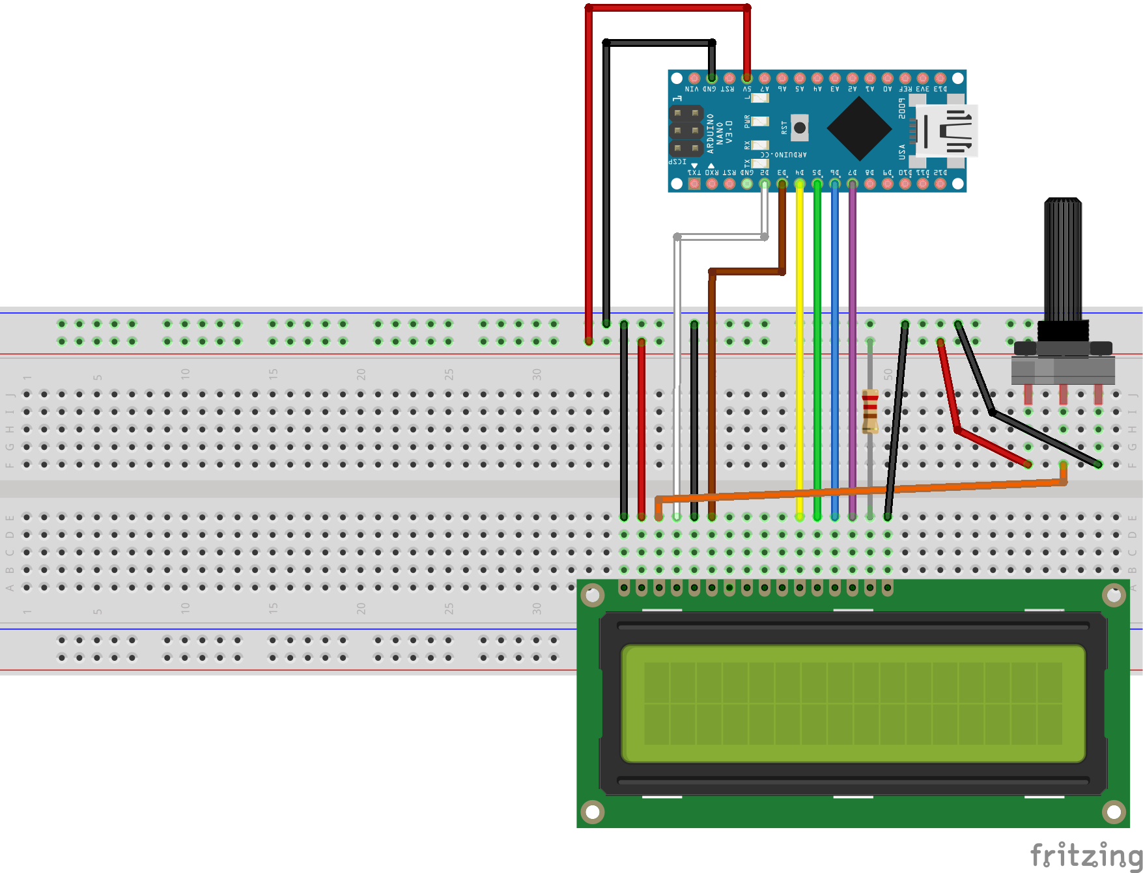

Slide 17
4.CONTROL SYSTEM
Use of Microcontroller:
• For maintaining the log.
• Reading Analog values of voltage from sensor as well as user interface.
• Producing PWM for maintaining speed and brightness for Fan and Bulb.
• Displaying in 16:2 LCD Display.

Slide 18
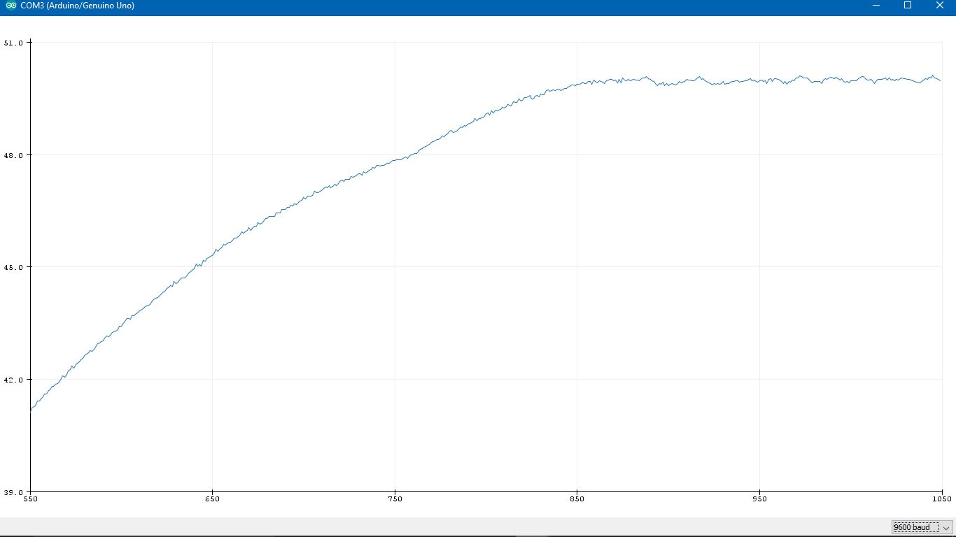
Graphical Plot ( Live Plot)
We have use the live graph plotter in Arduino and plot the graph between Temperature variation with Time.

Slide 19
Challenges
● Integration of small parts:​ ​ The main challenge of the project
was to build small modules and then make them work together.
The integrating part was challenging.
● Pin optimization​ : In Arduino Uno, we are using 19 pins out of 20.
Converted 2 analog pin in digital. Also proper managing and
use of multiplexer in 4 digits 7 segment display to reduce pin
count.
● Controlling 230 V AC current using Arduino which is DC: ​ For this,
we had to try a number of circuits. A couple of IC and
resistance even got burned down. The way out was to use
Optocoupler which avoids any direct connection with AC part.
At the end of the day, we are using almost all memory, all except 1
I/O pins and all three timers in Arduino Uno which was possible only
when we optimized the code and pins allocation.

Slide 20
Future Implementation
Adding more sensor like humidity, brightness, pressure etc.
Integrate it with the Internet of things(IOT)& control
through the internet.
Use the better cooling system to go below room
temperature. It would require a better understanding of
thermodynamic and related instruments.

Slide 21
Thanks

